Slide 1
ARCGIS PRO · SPATIAL DATA MODELS
Vector vs Raster Data
VECTOR
Discrete objects with boundaries — points, lines and polygons, each carrying its own attributes.
Every GIS layer is one of two things: a set of discrete features, or a continuous grid of values. This lesson shows how each model works, when to use it, and how to move between them.
Explore vector data →
RASTER
A continuous grid of equal-sized cells — every cell holds a value, ideal for surfaces and imagery.
01
Explore raster data →
Notes:
Agenda: definitions → properties → ArcGIS workflows → practice [Sources] - https://commons.wikimedia.org/wiki/File:Vectores_vs_rasters.png (image, CC BY-SA 3.0) [/Sources]

Slide 2
VECTOR VS RASTER DATA
02
Table of Contents
Click any row to go straight to that part of the lesson
Jump →
A
Foundations
Why two data models exist, and the vocabulary you'll need throughout.
Jump →
B
Vector Data
Geometry types, coordinates, attributes, and what they look like on a map.
Jump →
C
Raster Data
Cells, resolution, bands, and the imagery/elevation/land-cover examples.
Jump →
D
Practice & Recap
Hands-on lab, knowledge check, and what's next.

Slide 3
VECTOR VS RASTER DATA
03
Learning objectives
What you'll be able to do by the end of this lesson
Tell the models apart
Distinguish vector from raster — and know when to use each.
Understand vector
How points, lines & polygons store geometry plus attributes.
Understand raster
Cells, cell size / resolution, extent, and multi-band data.
Know the examples
Imagery, DEMs, land cover and parcels in the real world.
Choose the right model
Match vector or raster to each mapping or analysis task.

Slide 4
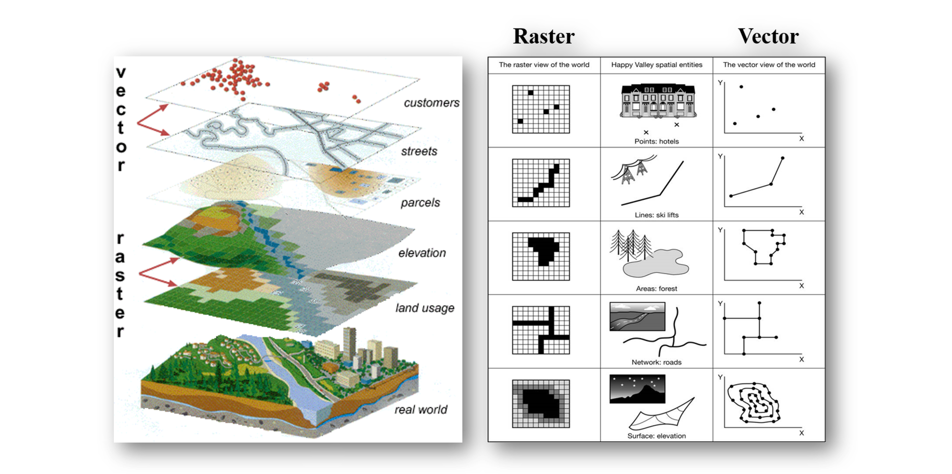
04
IN THE REAL WORLD
Two ways to see the world
Every GIS layer is either a set of discrete features or a continuous grid of values
The same landscape can be captured either way — as features or as a grid.

Slide 5
VECTOR VS RASTER DATA
05
Two spatial data models
Everything in a GIS is stored one of two ways
VECTOR
RASTER
Discrete objects
Continuous fields
Points, lines & polygons
A grid of equal-sized cells
Exact, scalable geometry
One value stored per cell
Every feature has attributes
Bands hold multiple values
Best for boundaries & networks
Best for surfaces & imagery
Notes:
[Sources] - https://commons.wikimedia.org/wiki/File:Vectores_vs_rasters.png (image, CC BY-SA 3.0) - https://support.esri.com/en-us/gis-dictionary/vector (definition: vector features as points/lines/polygons with attributes) - https://pro.arcgis.com/en/pro-app/latest/help/data/imagery/introduction-to-raster-data.htm (overview: rasters as cells/pixels; resolution vs storage/processing) [/Sources]

Slide 6
VECTOR VS RASTER DATA
06
Vector data essentials
How vector stores the world as discrete features
Geometry types
Points, lines and polygons build every vector feature.
Coordinates
Each vertex is an exact X, Y position — optionally Z and M.
Attributes
Every feature links to a row of descriptive fields in a table.
Topology & scale
Stores connectivity between features, and stays razor-sharp at any zoom.
Notes:
[Sources] - https://pro.arcgis.com/en/pro-app/latest/help/data/geodatabases/overview/feature-class-basics.htm (feature classes store geometry + attributes; point/line/polygon) - https://june-skeeter.github.io/geomatics-textbook/images/03-vector-types.png (image) [/Sources]

Slide 7
VECTOR VS RASTER DATA
07
Vector data examples
Three geometry types — the building blocks of vector data
POINTS
LINES
POLYGONS
REAL-WORLD
REAL-WORLD
REAL-WORLD
Wells, trees, GPS fixes, sample sites and addresses.
Roads, rivers, pipelines, transit routes and contours.
Parcels, lakes, land-use zones and watersheds.
TYPICAL ATTRIBUTES
TYPICAL ATTRIBUTES
TYPICAL ATTRIBUTES
depth · species · elevation · timestamp
name · length · speed · direction
area · owner · zoning · land-cover class

Slide 8
VECTOR VS RASTER DATA
08
Point, line, or polygon?
The same three geometry types, plotted the way they'd look on a real map
POINT
One coordinate pair — e.g., a monitoring well
LINE
POLYGON
Connected vertices — e.g., a road or stream
Closed boundary — e.g., a parcel or lake

Slide 9
VECTOR VS RASTER DATA
09
Raster data essentials
How raster stores the world as a grid of values
Cells (pixels)
A raster is a continuous grid of equal-sized square cells.
Cell size & resolution
Smaller cells capture more detail — but mean larger files.
Extent & origin
The grid is anchored in space by a corner coordinate and cell size.
Bands
Multiple bands stack values per cell, e.g. RGB or multispectral imagery.
Notes:
[Sources] - https://pro.arcgis.com/en/pro-app/latest/help/data/imagery/introduction-to-raster-data.htm (raster basics; resolution vs storage) - https://desktop.arcgis.com/en/arcmap/latest/manage-data/raster-and-images/cell-size-of-raster-data.htm (cell size/resolution affects detail and efficiency) - https://commons.wikimedia.org/wiki/File:Dalian,_China,_satellite_image,_LandSat-5,_2010-08-03.jpg (image, public domain NASA) [/Sources]

Slide 10
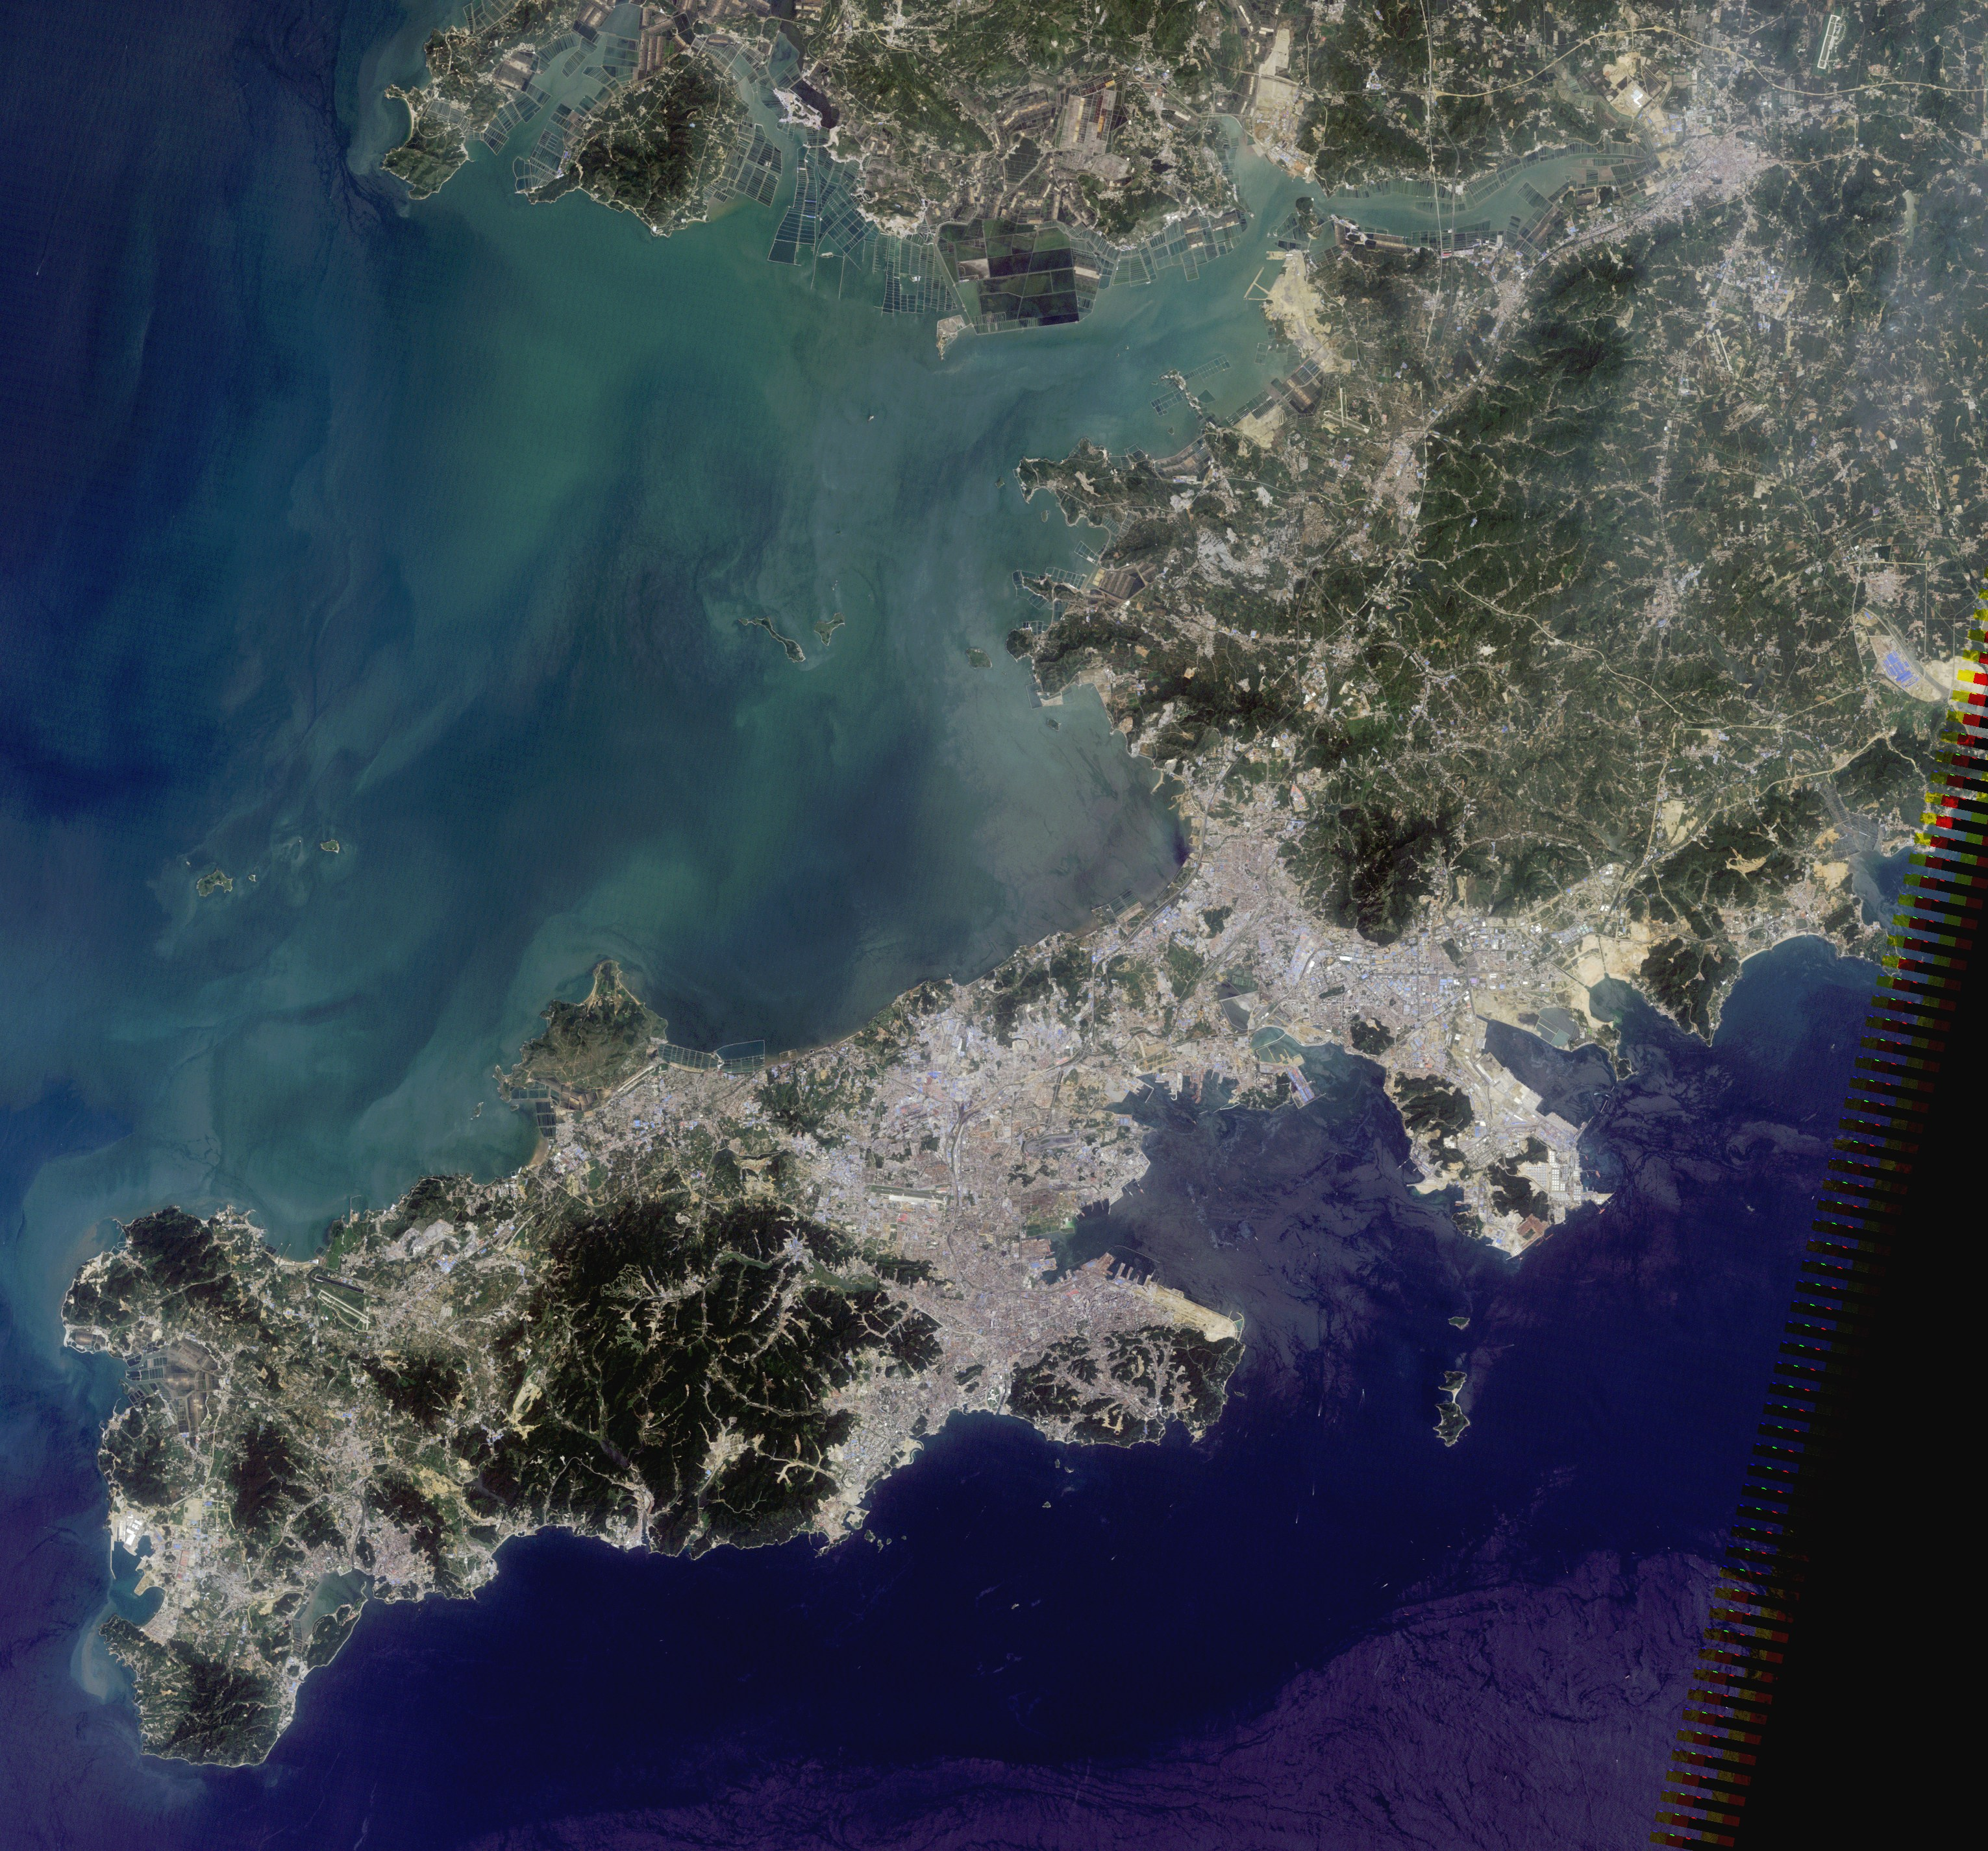
VECTOR VS RASTER DATA
10
Raster example: Satellite imagery
RGB — reflected light captured for every cell
Bands of light
Each cell stores reflected values — R, G, B, and often more bands.
Resolution
Cell size sets the detail: smaller pixels mean bigger files.
Analysis-ready
Powers classification, change detection and band math.
Satellite image · RGB composite
Notes:
[Sources] - https://commons.wikimedia.org/wiki/File:Dalian,_China,_satellite_image,_LandSat-5,_2010-08-03.jpg (image; public domain NASA) - https://pro.arcgis.com/en/pro-app/latest/help/data/imagery/introduction-to-raster-data.htm (raster data overview; imagery + analysis uses) - https://support.esri.com/en-us/knowledge-base/how-to-create-an-ndvi-map-in-arcgis-pro-000030690 (example of band math/NDVI workflow in ArcGIS Pro) [/Sources]

Slide 11
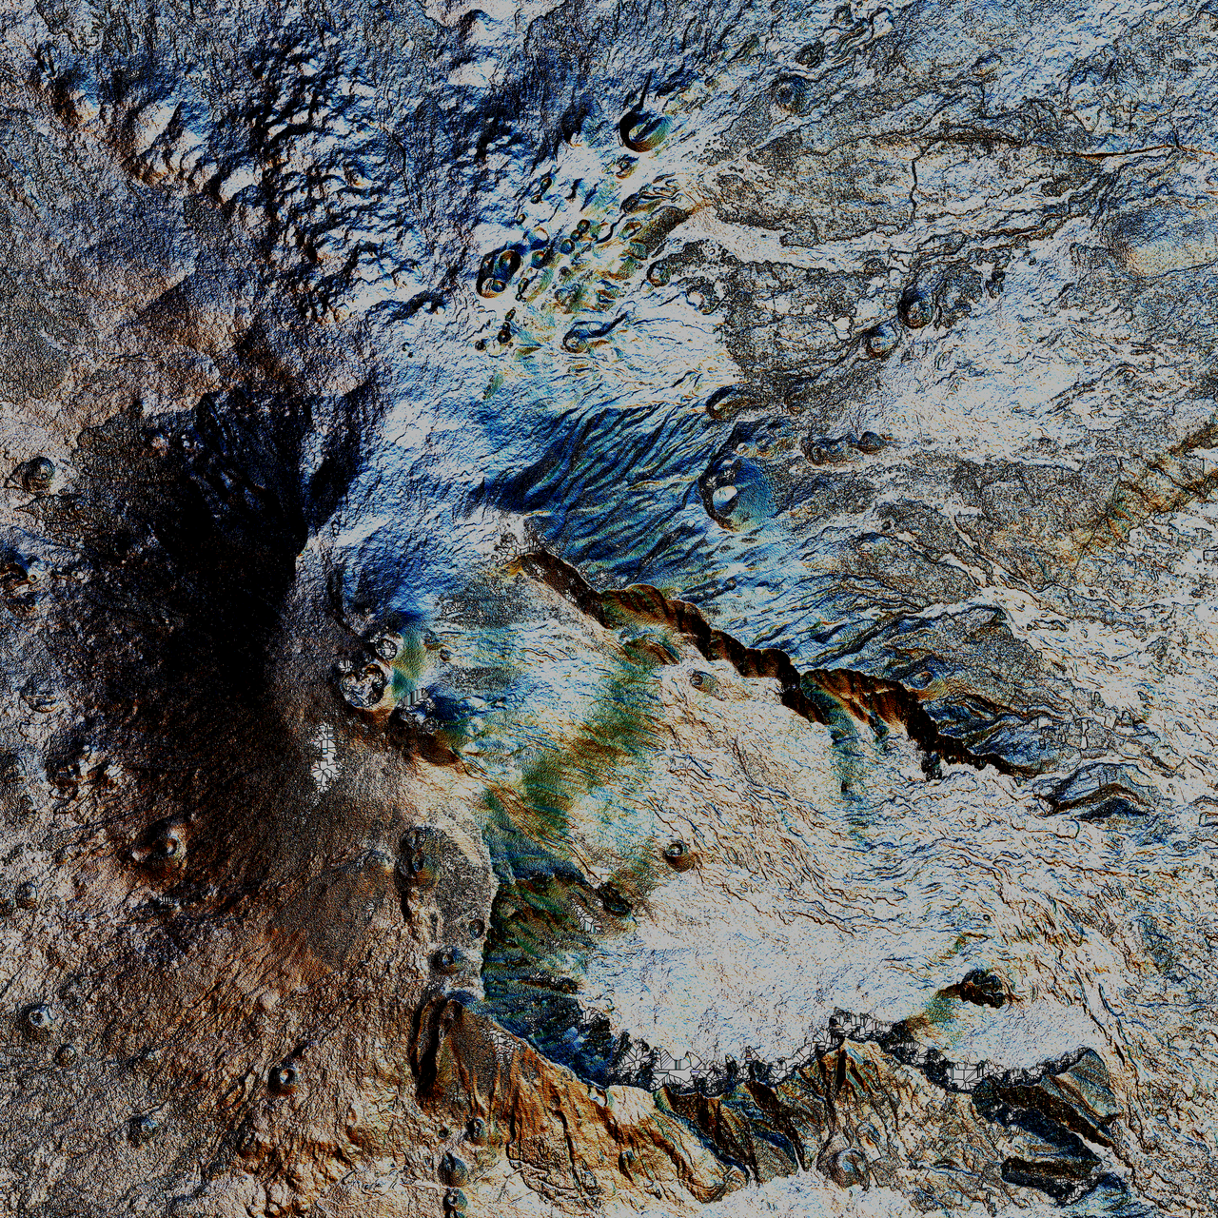
VECTOR VS RASTER DATA
11
Raster example: Elevation (DEM)
A continuous surface of ground height
Height per cell
Each cell stores an elevation value in metres or feet.
Derived surfaces
Slope, aspect, hillshade and watersheds all come from a DEM.
Continuous field
Elevation is defined everywhere — no gaps between samples.
Digital Elevation Model · hillshade
Notes:
[Sources] - https://commons.wikimedia.org/wiki/File:Etna_multidirectional_Hillshade.png (image; CC BY-SA 4.0) - https://www.usgs.gov/faqs/what-a-digital-elevation-model-dem (DEM definition) - https://pro.arcgis.com/en/pro-app/latest/help/data/imagery/introduction-to-raster-data.htm (rasters as grids/cells; analysis on surfaces) [/Sources]

Slide 12
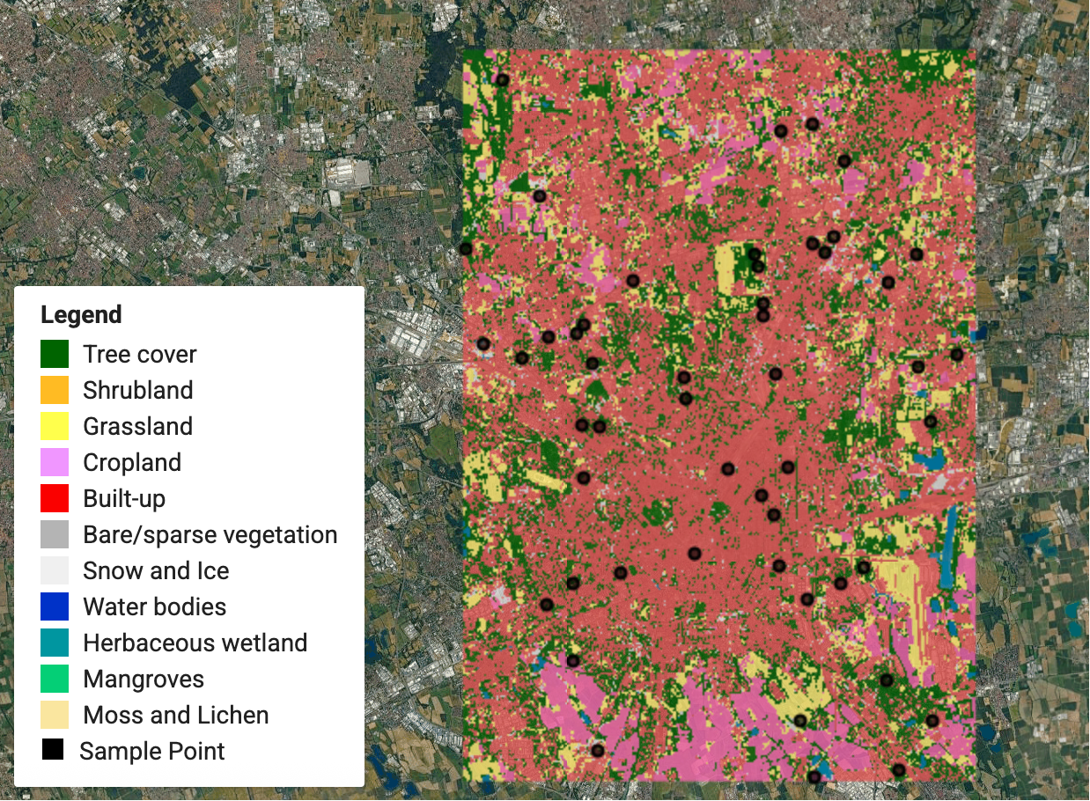
VECTOR VS RASTER DATA
12
Raster example: Land cover
Every cell labelled with a class
Classified cells
Each cell holds a category — water, forest, urban, cropland.
Built from imagery
Classification turns spectral bands into land-cover classes.
Area & change
Count cells to measure area and track change over time.
Land-cover classification
Notes:
[Sources] - https://commons.wikimedia.org/wiki/File:An_land_cover_map_with_samples.png (image; CC BY-SA 4.0) - https://pro.arcgis.com/en/pro-app/latest/help/data/imagery/introduction-to-raster-data.htm (thematic rasters; land-cover classification example) [/Sources]

Slide 13
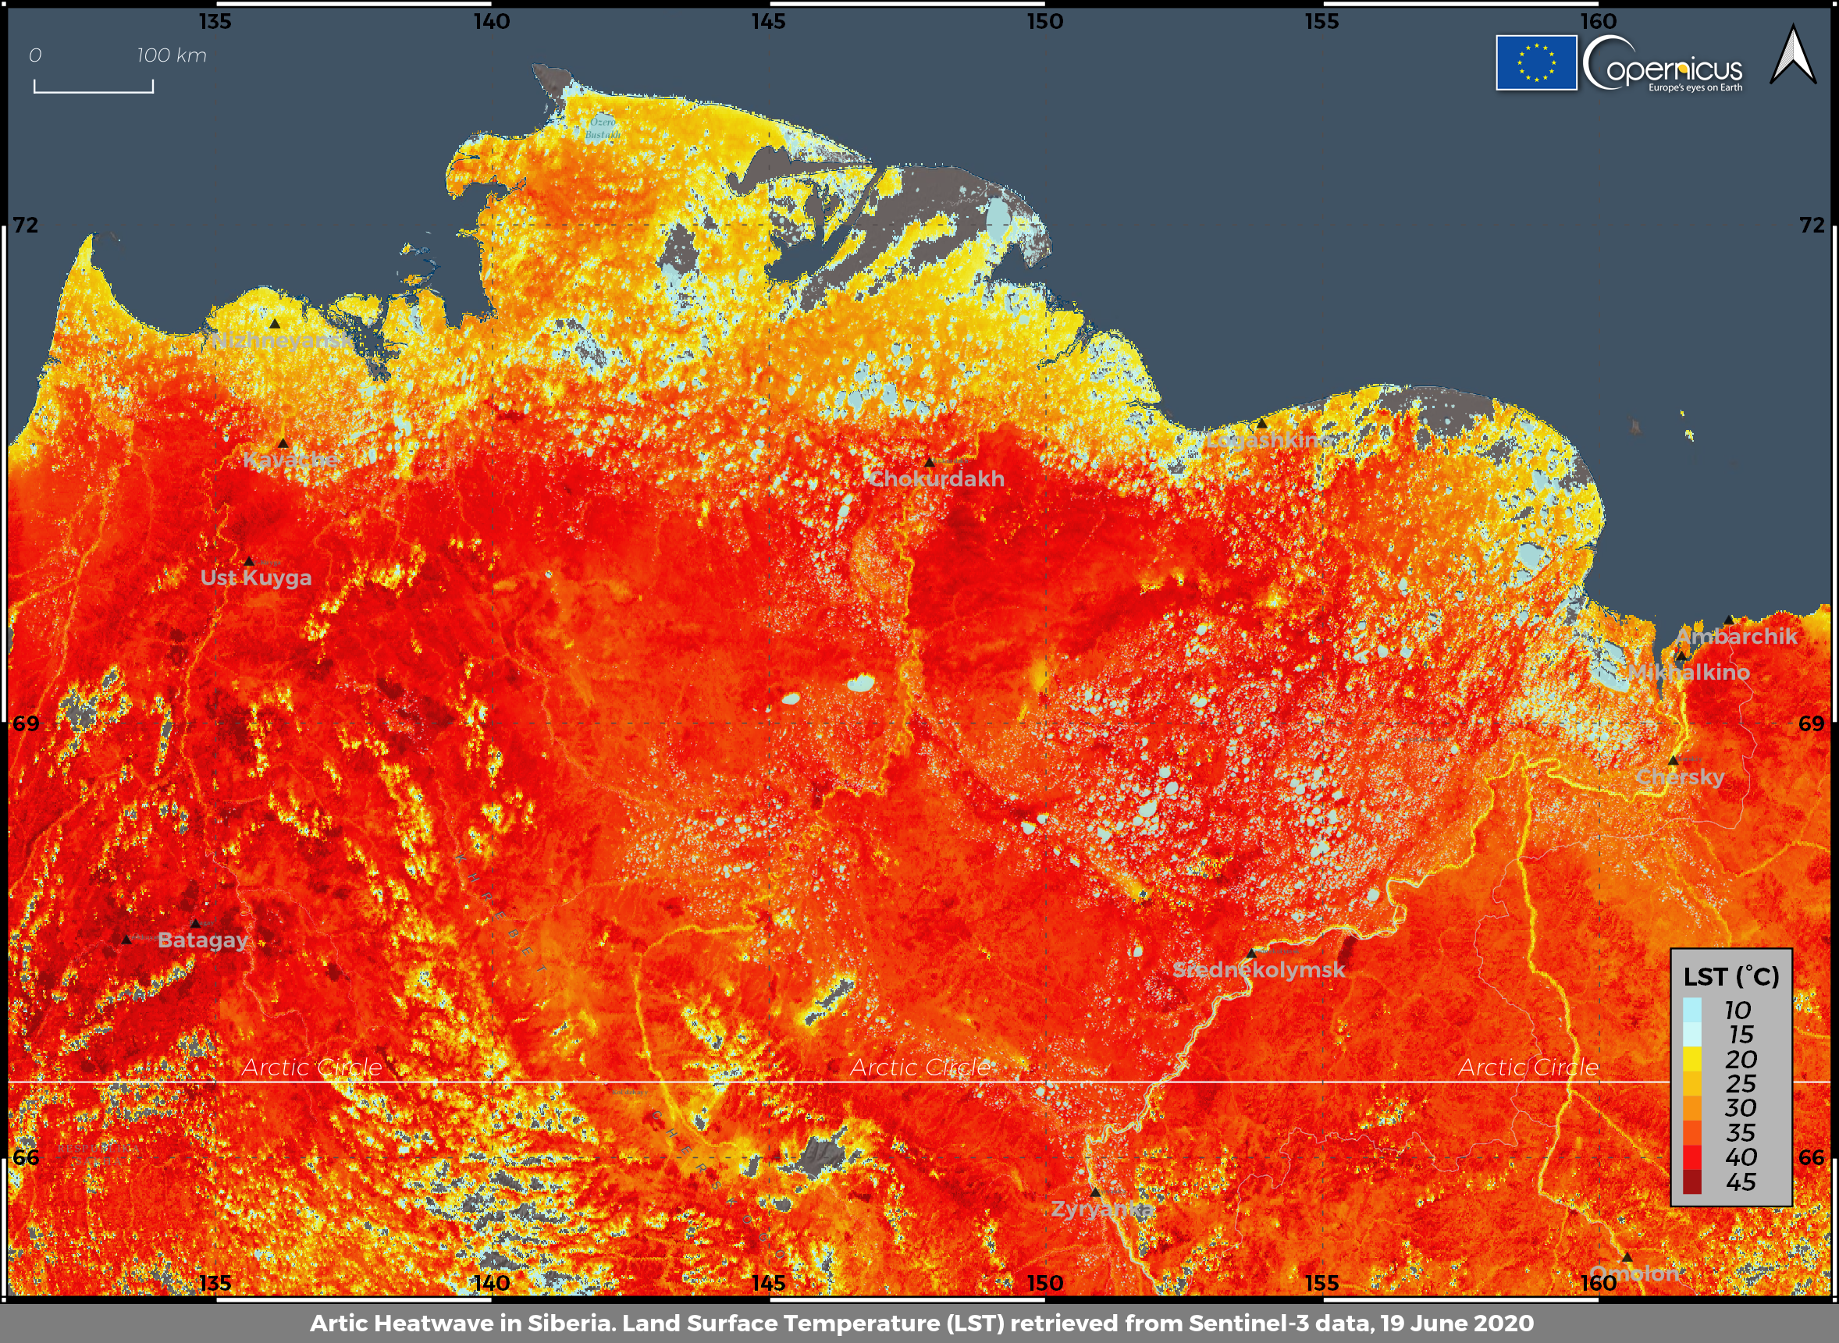
VECTOR VS RASTER DATA
13
Raster example: Temperature surface
A modelled, continuous climate field
Value per cell
Each cell stores a temperature estimated across the whole area.
Interpolation
Scattered point readings are modelled into a smooth grid.
Map algebra
Combine surfaces with raster math for deeper analysis.
Interpolated temperature surface
Notes:
[Sources] - https://commons.wikimedia.org/wiki/File:Land_Surface_Temperature_in_Siberia.png (image; Copernicus Sentinel data—attribution required) - https://pro.arcgis.com/en/pro-app/latest/tool-reference/spatial-analyst/an-overview-of-the-interpolation-tools.htm (IDW/kriging → raster surfaces) - https://pro.arcgis.com/en/pro-app/latest/help/data/imagery/introduction-to-raster-data.htm (continuous rasters; cell values and analysis) [/Sources]

Slide 14
VECTOR VS RASTER DATA
14
Choosing a model
Match the model to the question you're asking
ASPECT
VECTOR
RASTER
Structure
Coordinates — points, lines, polygons
Grid of equal-sized cells
Represents
Discrete objects with boundaries
Continuous fields and surfaces
Precision
Exact geometry; scales to any zoom
Fixed by cell size (resolution)
File size
Compact for sparse features
Grows with resolution and extent
Best analysis
Overlay, topology, networks
Map algebra, terrain, interpolation
Typical data
Parcels, roads, wells, zones
Imagery, DEMs, land cover, temperature

Slide 15
VECTOR VS RASTER DATA
15
Your turn — hands-on lab
Compare a vector layer and a raster in ArcGIS Pro
TASK
1
Add a vector layer (parcels or roads) and a raster (a DEM or satellite image) to your map.
ANSWER KEY
Step 3
Explore shows the pixel / band value for the cell you click.
Open the vector layer's attribute table — each row is one feature with its own attributes.
Click to reveal the Answer Key
2
Step 4
Layer Properties → Source lists the cell size (e.g., 30 m).
3
Use Explore to click a raster cell and read its value (elevation, band values, or class).
Step 5
Raster to Polygon builds polygons from cell zones.
4
Open the raster's Layer Properties → Source and note its cell size (spatial resolution).
EXPECTED RESULT
You can explain how vector stores discrete features (each row = a feature) while raster stores a value per cell — and when to convert between them.
Click to reveal the Expected Result
5
Run Raster to Polygon (Conversion Tools) and compare the output to the original raster.

Slide 16
VECTOR VS RASTER DATA
16
Knowledge check
Check your understanding of vector and raster data
1
Which data model stores features as coordinates with attributes?
2
What does a smaller raster cell size mean?
ANSWER
ANSWER
Click to reveal answer
Click to reveal answer
Vector — points, lines and polygons defined by coordinate pairs, each with an attribute record.
Higher spatial resolution — more detail, but a larger file and heavier processing.
3
Which model best represents a continuous surface such as elevation?
4
You need precise parcel boundaries and network topology. Which model?
ANSWER
ANSWER
Click to reveal answer
Click to reveal answer
Raster — every cell holds a value, so the surface is defined everywhere.
Vector — exact geometry plus the topology and connectivity networks rely on.

Slide 17
VECTOR VS RASTER DATA
17
Recap and what's next
You can tell vector from raster — next, put attributes to work
Two data models
Structure drives use
Resolution matters
Match model to task
Vector = discrete objects; raster = a continuous grid of cells.
Coordinates + attributes vs one value stored per cell.
Smaller raster cells: more detail, but larger files.
Boundaries & networks → vector; surfaces → raster.
UP NEXT
Common GIS file & project formats
File Management
Folder structure that scales
You can tell vector from raster — next, get organized: file formats, folder structure, and naming conventions that keep a GIS project usable.
Naming habits your future self will thank you for

